Slide 1
Accelerating Health Equity And Eliminating Diabetes Disparities in Community Health Centers (AHEAD)
Matthew O’Brien, MD, MSc and Marshall Chin, MD, MPH,
Co-Directors, AHEAD Core
Chicago Center for Diabetes Translation Research

Slide 2
Chicago Center for
Diabetes Translation Research
Chicago CCDTR is a collaboration between University of Chicago and Northwestern University
Cores support diabetes translation research:
  Administrative core
  Pilot and feasibility core
  Enrichment core
  Research design, data & analytics core
  Community engagement & health equity core
  AHEAD national core

Slide 3
Community Health Center Partners in AHEAD

Slide 4
AllianceChicago (Alliance)
70 CHCs in 19 states
serving ~3 million patients
Health Choice Network (HCN)
44 CHCs in 16 states
Serving ~2.6 million patients
Midwest Clinicians Network (MWCN)
150 CHCs in 10 states
Clinical Directors Network (CDN)
>600 CHCs nationally – Dissemination Partner

Slide 5
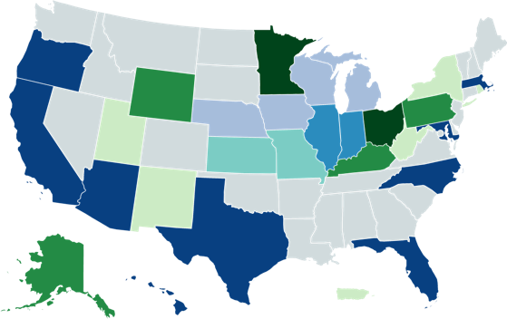
National Reach of AHEAD
Alliance + HCN + MWCN
Alliance + HCN
Alliance + MWCN
HCN + MWCN
Alliance only
HCN only
MWCN only
Puerto Rico

Slide 6
AHEAD Aim 1
To provide access to an existing national data repository of CHC patients that will accelerate collaborative, large-scale diabetes translation research
Current data repository includes:
  1,081,492 patients aged ≥9 years old in AllianceChicago network
  2,920 diagnosis codes
  131 unique laboratory studies
  12,601 unique medications

Slide 7
AHEAD Aim 2
To offer academic investigators and CHC clinicians consultative services that support research partnerships and accelerate novel diabetes translation research
  Identifying research partners
  Developing/refining research questions
  Conducting “prep for research” analyses
  Navigating study implementation
  Disseminating products locally

Slide 8
AHEAD Aim 3
To disseminate products of successful diabetes translation research to an existing national network of relevant stakeholders
  Webinars hosted by Clinical Directors Network (CDN) partnership
  Dissemination activities offered by CHC partners
  Dissemination activities offered by CCDTR

Slide 9
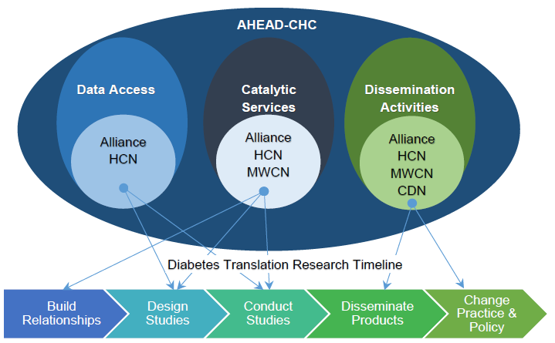
Overview of AHEAD

Slide 10
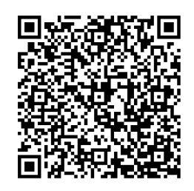
Contact Us
To request services from the Chicago Center for Diabetes Translation Research:
Fill out our request form: https://redcap.link/ccdtr
Email: cdtr@uchicago.edu
Stay tuned for our new website launch

Slide 11




Development of social drivers of health cluster scores and correlation with diabetes and hypertension outcomes
September 2022
Dave Faldmo¹, Wen Wan², Rosy Chang Weir³,
Marshall Chin², Erin Hoefling¹, Vivian Li
¹Siouxland Community Health Center
²University of Chicago
³Association of Asian Pacific Community Health Organizations (AAPCHO)
Funded by The Chicago Center for Diabetes Translation Research (NIDDK P30 DK092949)
Notes:
Rosy

Slide 12
Partners
This project is funded by The Chicago Center for Diabetes Translation Research (NIDDK P30 DK092949)
Notes:
Rosy
May not need the slide if introduced partners on slide 1

Slide 13
Overview
Study Aims
PRAPARE®/SDOH at Siouxland Community Health Center
Study Methodology and Results
Impact of the Findings
Q&A
Notes:
Rosy

Slide 14
Study Aims
To identify clusters of social risk factors in a population that included patients with diabetes and hypertension
To find effective methods for scoring PRAPARE®/ SDOH factors for use in correlational analyses, including risk stratification
To assess the relationship between SDOH factors and hemoglobin A1c and blood pressure values, including diabetes and hypertension control
Notes:
Rosy

Slide 15
Importance of SDOH and Concise Screening/Scoring Tools
Laotian
Mandarin
Mien
Punjabi
Samoan
Tagalog
Thai
Tibetan
Tongan
Vietnamese
SDOH impact health outcomes
SDOH Screening Tools are useful for:
  Individual patient care
  Risk stratification for population health management
  Risk adjustment for public reporting and payment
What is PRAPARE?
Protocol for Responding to & Assessing Patients’ Assets, Risks & Experiences:
A national standardized patient risk assessment protocol designed to engage patients in assessing & addressing social determinants of health (SDH). PRAPARE is evidence-based and stakeholder-driven, containing measures on 21 SDH that align with national initiatives, such as IOM recommendations and Meaningful Use Stage 3. PRAPARE also maps to other codes including ICD 10, SNOMED, and LOINC (forthcoming). The PRAPARE survey included 17 core and 4 optional questions. The PRAPARE core questions included domains of 1) Personal Characteristics, 2) Family and Home, 3) Money and Resources, 4) Social and Emotional Health. This analysis included only the core questions consisting of 21 total measures.
As one of the first PRAPARE pilot sites, the Siouxland Community Health Center, Sioux City, Iowa, began implementing PRAPARE in 2015.
Notes:
Rosy

Slide 16
PRAPARE® - SDOH Screening Tool
Protocol for Responding to & Assessing Patients’ Assets, Risks & Experiences (AAPCHO, NACHC, OPCA)
National standardized, evidence-based and stakeholder-driven. Toolkit and much more info at prapare.org
17 core and 4 optional questions, which covers 4 domains:
  Personal Characteristics
  Family and Home
  Money and Resources
  Social and Emotional Health
Laotian
Mandarin
Mien
Punjabi
Samoan
Tagalog
Thai
Tibetan
Tongan
Vietnamese
What is PRAPARE?
Protocol for Responding to & Assessing Patients’ Assets, Risks & Experiences:
A national standardized patient risk assessment protocol designed to engage patients in assessing & addressing social determinants of health (SDH). PRAPARE is evidence-based and stakeholder-driven, containing measures on 21 SDH that align with national initiatives, such as IOM recommendations and Meaningful Use Stage 3. PRAPARE also maps to other codes including ICD 10, SNOMED, and LOINC (forthcoming). The PRAPARE survey included 17 core and 4 optional questions. The PRAPARE core questions included domains of 1) Personal Characteristics, 2) Family and Home, 3) Money and Resources, 4) Social and Emotional Health. This analysis included only the core questions consisting of 21 total measures.
As one of the first PRAPARE pilot sites, the Siouxland Community Health Center, Sioux City, Iowa, began implementing PRAPARE in 2015.
Notes:
Rosy
Protocol for Responding to & Assessing Patients’ Assets, Risks & Experiences:
A national standardized patient risk assessment protocol designed to engage patients in assessing & addressing social determinants of health (SDH). This was designed in collaboration with AAPCHO, NACHC,a nd OPCA.
PRAPARE is evidence-based and stakeholder-driven, containing measures on 21 SDH that align with national initiatives, such as IOM recommendations and Meaningful Use Stage 3. PRAPARE also maps to other codes including ICD 10, SNOMED, and LOINC and has been translated in multiple languages. 10-chapter Toolkit is available online. The PRAPARE survey included 17 core and 4 optional questions. The PRAPARE core questions included domains of 1) Personal Characteristics, 2) Family and Home, 3) Money and Resources, 4) Social and Emotional Health. This analysis included only the core questions consisting of 21 total measures.
Questions can be found on prapare.org

Slide 17
PRAPARE® - SDOH at Siouxland
Siouxland Community Health Center, Sioux City, Iowa
One of the first PRAPARE pilot sites, began implementing PRAPARE in 2015.
Laotian
Mandarin
Mien
Punjabi
Samoan
Tagalog
Thai
Tibetan
Tongan
Vietnamese
Notes:
Dave

Slide 18
PRAPARE® - SDOH Workflow at Siouxland
Laotian
Mandarin
Mien
Punjabi
Samoan
Tagalog
Thai
Tibetan
Tongan
Vietnamese
Notes:
Dave

Slide 19
Siouxland Interventions to Address Food Insecurity for Diabetic Patients
Voices for Food/Grow an Extra Row
Partner with state extension office program to provide fresh produce donated by community gardeners to patients in need at health center
Demonstration Garden Boxes at Health Center
Healthy Cooking Classes
Partner with YMCA to provide cooking class at local grocery store
Grocery Store Tours
Partner with local grocery store to provides dietician-led tour of grocery store
Increased staff knowledge of community food pantries, soup kitchens, and other resources
Notes:
Dave

Slide 20
Study Population
11,773 adults, aged 18-75
Visited Siouxland Community Health Center between 1/1/2016 to 6/30/2018 and responded to the PRAPARE survey
Blood pressure and hemoglobin A1c (HbA1c) records
      716 had diabetes only
      2,388 had hypertension only
      1,477 had both
      7,192 had neither disease
Laotian
Mandarin
Mien
Punjabi
Samoan
Tagalog
Thai
Tibetan
Tongan
Vietnamese
Notes:
Wen
This cross sectional study included 11,773 adults, aged 18-75, who visited Siouxland Community Health Center (Sioux City, Iowa) between 1/1/2016 to 6/30/2018 and responded to the PRAPARE survey. The blood pressure and hemoglobin A1c (HbA1c) records included were the patients’ most recent measures. All blood pressure records were also between 1/1/2016 to 6/30/2018, whereas most HbA1c records were also within the time frame, except for one record from 2013 and two records 2015. Among the 11,773 patients, 716 had diabetes only, 2,388 had hypertension only, 1,477 had both, and 7,192 had neither disease.

Slide 21
Structure of PRAPARE SDOH Factors by Factor Analysis
13 PRAPARE SDOH FACTORS
STANDALONE CLUSTERS
Cluster 1: Social Background
- Language
- Ethnicity
- Education
- Race
Cluster 2: Social Insecurities
- Housing Security
- Material Needs Composite
- Transportation
- Health Care Needs
- Stress
- Domestic Violence
- Safety
Cluster 3: Insurance/Employment
- Insurance
- Employment
Cluster 4: Federal Poverty Level
Cluster 5: Social Integration
Cluster 6: Housing Status
Highest possible score: 4
Highest possible score: 7
Highest possible score: 2
Each highest possible score: 1
Highest possible SDOH total risk Score: 16
Notes:
Wen
The six methods of constructing factor scores all led to similar results, therefore we moved forward with a simpler weighted mean of all variables in the same SDH cluster. If there is missing data, weights for missing values were 0. Thus, Social Background score was calculated as a weighted mean of […], Social Insecurities score was calculated as[..], and Insurance/Employment score was calculated as […] The Overall SDH Score was calculated as a sum of Social Background, Social Insecurities, Insurance/Employment, and FPL, Social Integration/Isolation and Housing Status scores.
The material needs composite in the 2nd cluster -Social Insecurities combined and averaged five SDH factors: needs in food, utilities, childcare, clothing and phone, due to their naturally high correlation with pairwise polychoric correlation coefficients (≥0.87). The factor migrant status was not included in the factor analysis due to lack of migrants in the patient population.

Slide 22
Results via Logistic Regression
Factor | UNCTL DM | UNCTL HTN | Combined UNCTL
 | Odds Ratio
Gender | 0.88 | 0.90 | 0.87
Age | 0.97 | 1.00 | 0.99
BMI | 0.99 | 1.00 | 1.01
C1: Social Background Score | 1.12 | 1.00 | 1.06
C2: Social Insecurities Score | 1.18 | 1.16 | 1.17
C3: Insurance/Employment Score | 1.24 | 1.09 | 1.17
C4: Federal Poverty Level | 0.69 | 1.31 | 1.02
C5: Housing Status | 0.77 | 1.19 | 1.04
C6: Social Isolation | 0.85 | 1.13 | 1.07
Notes:
Wen
Among those who had diabetes and/or hypertension, the odds of uncontrolled disease were increased by 6% - 17% as the three risk scores increased by 1.

Slide 23

Conclusions
Social risks are associated with diabetes and hypertension
Importance of screening for social risk and in understanding SDOH in patients with chronic conditions
Association between the number of social risks with worse disease outcomes broad, comprehensive screening
Across all models, patients scoring higher in “Social Insecurities,” worse disease outcomes closer follow up on this cluster in disease monitoring
Implications for clinical interventions: risk stratification, predicting high risk, high cost patients and risk adjustment
Notes:
Rosy
Our analysis using national standard PRAPARE SDH data demonstrated that social risks are associated with diabetes and hypertension and supports the importance of screening for social risk and in understanding SDH in patients with chronic conditions. These results also suggest that distinct groups of controlled and uncontrolled disease can be differentiated using PRAPARE supporting known-groups validity of PRAPARE. Taken together with the “good” to “excellent” internal consistency reliability results we observed, this study contributes to the overall validity of PRAPARE.
Our study also provides a first look at clusters of a comprehensive SDH screening tool using patient-level PRAPARE data. Similar to past studies, our analysis, demonstrating the association between the number of social risks with worse disease outcomes, supports broad, comprehensive screening. Across all models, however, patients scoring higher in “Social Insecurities,” the SDH cluster that included Housing Security, the Material Needs Composite, Transportation, Health Care Needs, Stress, Domestic Violence, and Safety, were significantly associated with worse disease outcomes, demonstrating that this cluster may warrant closer follow up in disease monitoring. Overall, having knowledge of the number and type of patient social risks could also lead to more effective risk stratification approaches to facilitate patient-centered care management for complex patients, as well as facilitate improved methods for predicting high risk, high cost patients and risk adjustment for more appropriate payment for organizations serving higher risk patient populations.
Results from this study can inform clinical intervention strategies that may greatly improve care processes and clinical outcomes for patients with diabetes and hypertension. Identifying the impact of specific SDH and the most effective services and interventions would help guide prevention priorities and possible policy solutions for addressing the root causes of poor health. With this knowledge and data, all stakeholders ranging from patients, providers, health plans, and payers can benefit by providing and receiving care that is appropriate, effective, and cost-saving.

Slide 24
Challenges and Opportunities for FQHC Diabetes Research
Challenges:
  Competing priorities
  Limited financial resources
  Lack of research/data analytic expertise/training
Advantages:
  FQHC quality improvement experiences and infrastructure
  Research can help reduce disparities and health inequities
  Collaborative partners/academia recognize the value of FQHCs and the population we serve
Notes:
Dave
Challenges:
Competing priorities
Limited financial resources
Dedicating staff/resources to participate in research
Lack funding and awareness of funding opportunities
Lack of research/data analytic expertise/training
apply for and conducting research (IRBs, RCT)
methods to publish/share findings
inexperience in working with collaborative partners/academia
Advantages:
FQHC quality improvement experiences and infrastructure
UDS reporting, PCMH, OSVs, PCAs/HCCNs, NACHC, etc
PDSA, Care Transformation, PRAPARE
Research can help us reduce disparities and health inequities
Collaborative partners/academia recognize the value of FQHCs and the population we serve

Slide 25
Q&A
Thanks to The Chicago Center for Diabetes Translation Research through NIH/NIDDK for funding this project
Publication: https://www.jabfm.org/content/35/4/668
Thank you!

Slide 26
Diabetes Screening in Community Health Centers:
A journey spanning research, policy, and practice
Matthew O’Brien, MD, MSc
Associate Professor of Medicine
Northwestern University
Co-Director, AHEAD-CHC
Nivedita Mohanty, MD
Chief Research Officer, AllianceChicago
Clinical Associate Professor,
Northwestern University
Site PI, AHEAD-CHC

Slide 27
Overview
  Diabetes screening study analyzing secondary data from community health centers (CHCs)
  Translation of evidence into new diabetes screening policy
  Diabetes risk modeling study using the same CHC data
  Future directions in research, policy, practice

Slide 28
USPSTF Diabetes Screening Recommendation
  Released December 2015: “The USPSTF recommends screening for abnormal blood glucose as part of cardiovascular risk assessment in adults aged 40 to 70 years who are overweight or obese.”
  What are the implications for racial and ethnic minority groups, who:
  Develop diabetes at younger ages than White adults¹
  Experience higher diabetes risk than White adults at normal weight^{2,3}
Wang, et al. JAMA Intern Med 2021;181:1537-9
Hsu, et al. Diabetes Care 2015;38(1):150-8
Gujral, et al. Ann Intern Med 2017;166:628-36

Slide 29
Performance of 2015 USPSTF Diabetes Screening Criteria in Community Health Centers
Aim/objective: among adult community health center patients without prediabetes or diabetes at baseline:
  Estimate the clinical performance of the USPSTF screening criteria to detect incident prediabetes and diabetes cases during 3-years of follow-up

Slide 30
Methods
Study design: Retrospective cohort study of clinical data (2008-2013) with an index patient visit in 2008-2010 and up to 3 years of follow-up
Data source: Electronic health records
Setting: 6 large safety-net community health centers in the Midwest and Southwest
Participants: 50,515 adult patients without prediabetes or diabetes at baseline, followed for up to 3 years

Slide 31
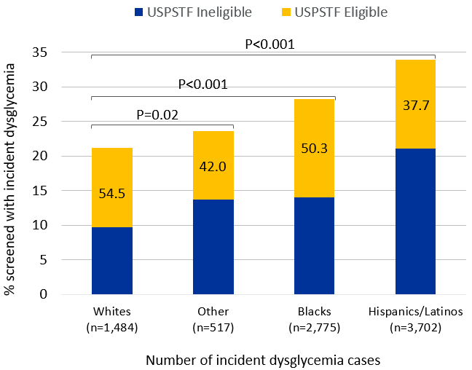
O’Brien, et al. PLOS Medicine 2016;13:e1002074

Slide 32
Translation of findings to policy (2018->2021)
Outreach from Diabetes Advocacy Alliance
Letter from Diabetes Advocacy Alliance to HHS Secretary Burwell
Invited presentation at Congressional Black Caucus
USPSTF announced re-review of diabetes screening criteria with focus on health equity
USPSTF literature review and public comment on draft criteria

Slide 33

New diabetes screening recommendation:
August 31, 2021
Implications for health equity:
Lowers screening age from 40 to 35 years old (+ overweight/obesity)
Mentions that clinicians should consider screening earlier in members of high-risk groups (including racial/ethnic minorities)
Explicitly acknowledges Asian-specific BMI cutoffs

Slide 34
Future directions in research
Implementation study of the 2021 screening recommendation:
Multi-component, multi-level intervention aimed to improve screening rates using:
  Provider-facing components: clinical decision support, audit and feedback reports
  Patient-facing components: education materials, text messages
R01 proposal is currently under review at NIH
Seeking community health center partners who want to participate

Slide 35
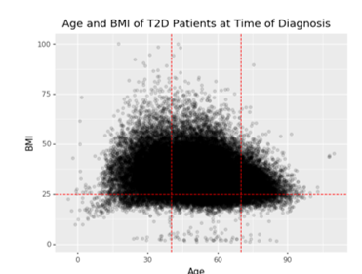
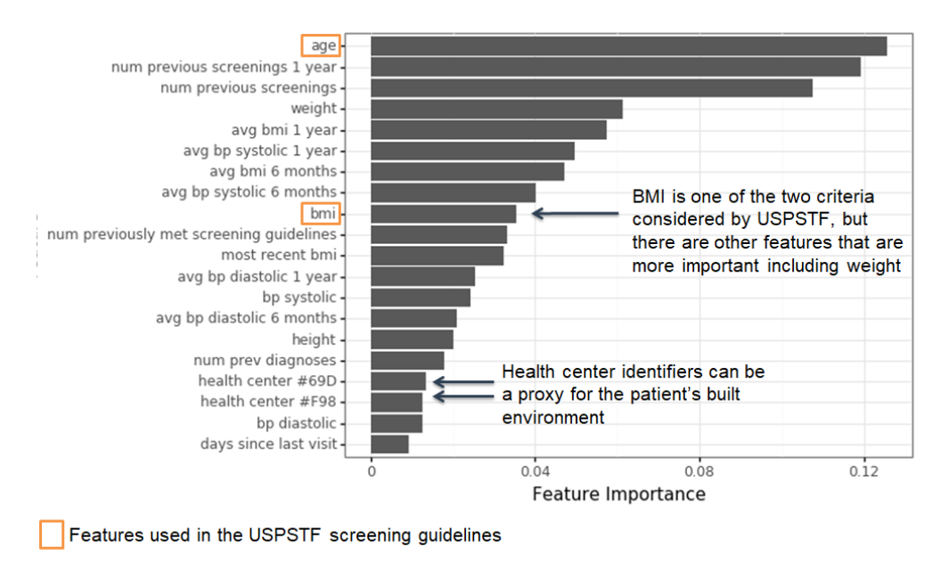
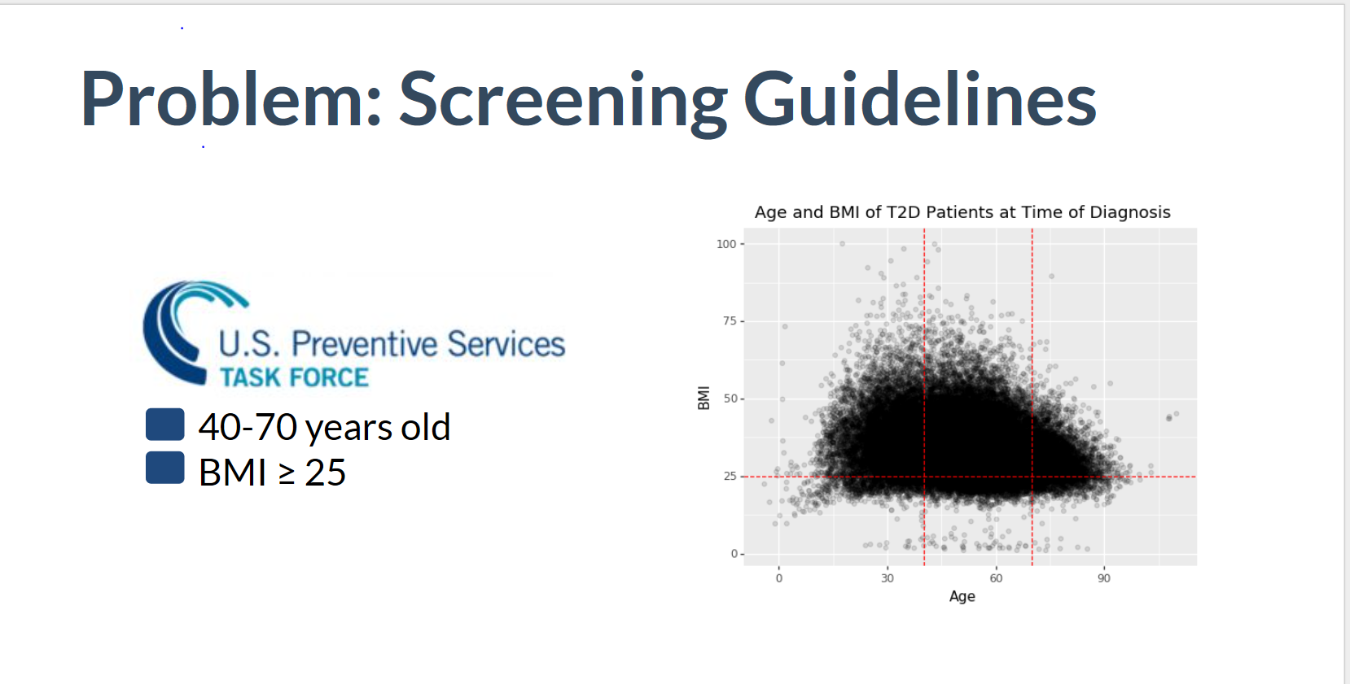

Diabetes Screening: Traditional vs. AI Approach
Opportunity: A Personalized risk score tool for clinicians
Proactive interventions for CHC patients at risk of developing diabetes

Slide 36
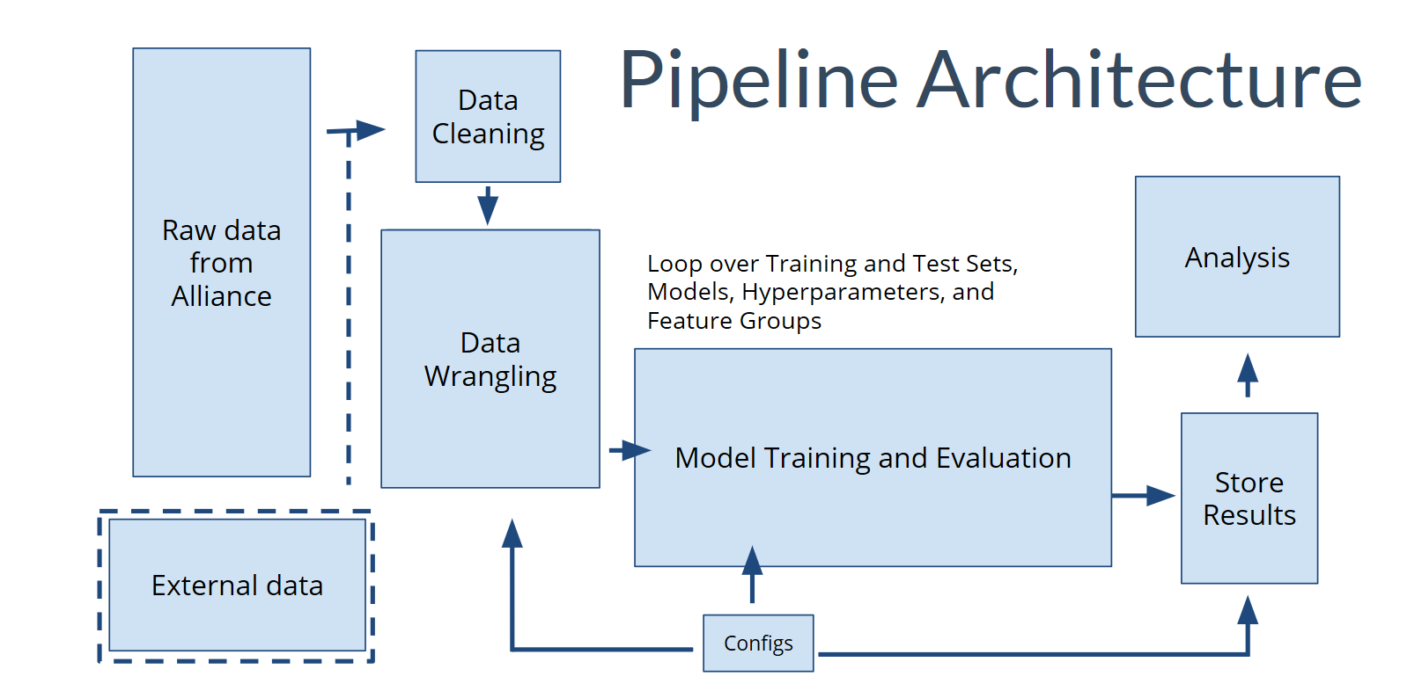
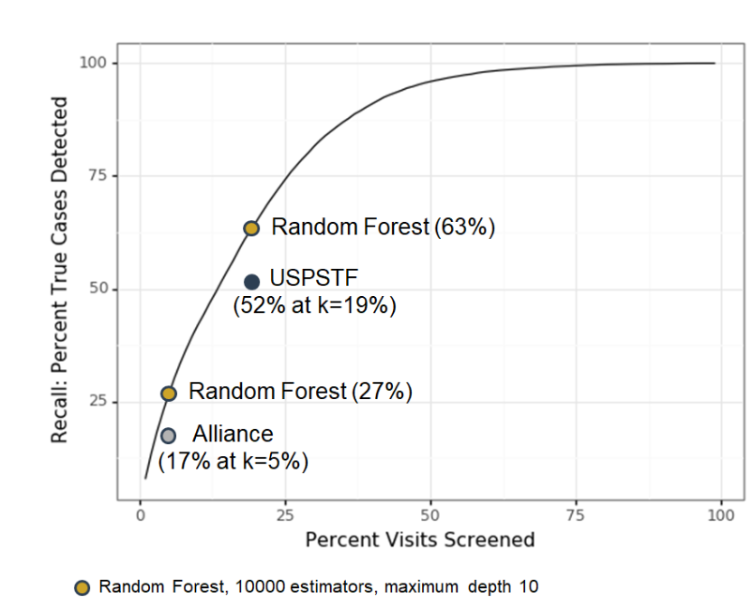






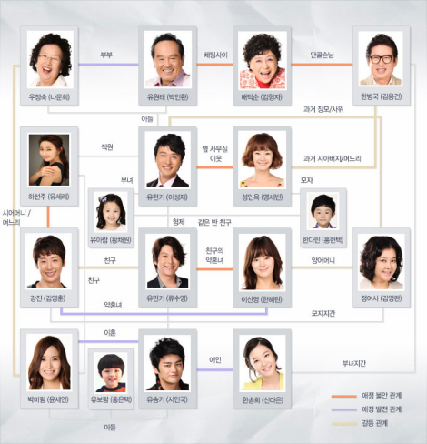
Medications
Visits Observations
Diagnoses
Demographics
American Community Survey (ACS)
Lab results
Family History
This Photo by Unknown Author is licensed under CC BY-NC-ND

Slide 37
Future directions in research
Develop interventions that leverage this risk model for improving primary care in community health centers
Provider-facing clinical decision support displaying patients’ risk of developing diabetes, which will inform their clinical care
Patient-facing educational materials informing patients of their risk of developing diabetes and encouraging healthy lifestyle changes to prevent diabetes

Slide 38
THANK YOU!
Nivedita Mohanty
nmohanty@alliancechicago.org
Matthew O’Brien
matthew.obrien1@northwestern.edu

Slide 39


Conducting Research with Community Health Centers
Cynthia Schaefer, PhD, RN
Arshiya A. Baig, MD, MPH

Slide 40
Community-Based Participatory Research Partnership
University of Chicago/Midwest Clinicians’ Network
  Diabetes translation research since 1997
  MWCN Research Committee
  Collaborations
    Needs assessments
    Partner identification
    Projects: Diabetes Standards of Care, Health Disparities Collaborative, Health Center Diabetes Pilots, Hypertension/Lipids, Health Literacy, Diabetes and Depression, Combating Obesity, Group Visits, Virtual Group Visits (Chicago)

Slide 41
Midwest Clinicians’ Network
The network includes 150 health centers and 10 Primary Care Associations in a 10 state region
Focus on networking, education and resources for FQHCs
High utilization of listserv by members for best practices
Patient experience and employee satisfaction surveys
Research since late 1990’s
The Midwest Clinicians' Network, Inc.'s mission is to enhance professional and personal growth for clinicians to become effective leaders for their health centers and promoters of quality, community-based primary health care.

Slide 42
Engagement Methods
Board of Directors
Primary Care Associations
Listserv outreach
  Survey specific topics for informational purposes
  Feedback on topic interest
  Recruit letters of support
  Notify of opportunities
  Share results
Webinar
Newsletter

Slide 43
Outcomes/Dissemination
Publications
Poster presentations (NACHC, ADA, SGIM, etc.)
Dissemination to members
  Webinar presentations
  Newsletter
Facilitate health centers participants sharing
  Provide resources to leadership/board/staff
  Funding for travel to state/national meetings

Slide 44
MWCN & UChicago
Diabetes Group Visits
Interest/Concept Development
  MWCN BOD expressed interest in shared medical appointments for patients with diabetes.
  MWCN Research Committee worked with U Chicago.
Site visit study (2013-2014)
  Interviewed health center staff at 5 HCs in the Midwest to collect information on their experience running diabetes group visits.
Pilot study (2015-16)
  Trained 6 HCs in 5 states to conduct diabetes group visits.
  Included text messaging at 1 health center.
Diabetes MESSAGES study (2017-22)
  Train 14 HC teams in Midwestern states to conduct diabetes group visit & text messaging program.
  Cluster randomized controlled design.
Notes:
AB: can delete slide if over time
-site visit study?
-pilot study
-diabetes MESSAGES: a bit redundant…

Slide 45

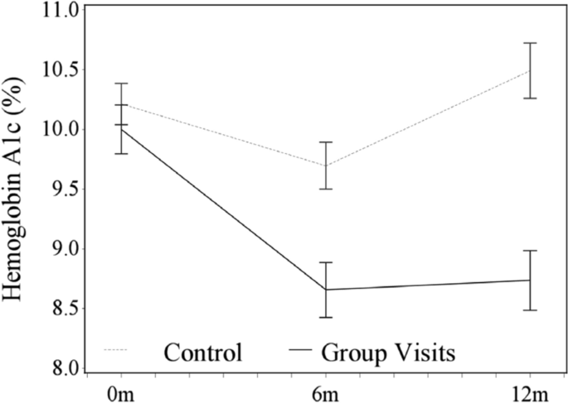
Pilot Study
Overview
Design:
  Trained 26 staff at 6 community health centers in 5 Midwestern states to implement group visits (3 urban, 3 rural)
  Health centers recruited 8-10 patients with uncontrolled diabetes (HbA1c > 8%)
  Implemented 6 monthly diabetes group visits
Results
  51 patients enrolled, 61% attended > 4 visits
  Improvement in A1c for GV patients
  High provider and staff satisfaction
Notes:
Years?

Slide 46
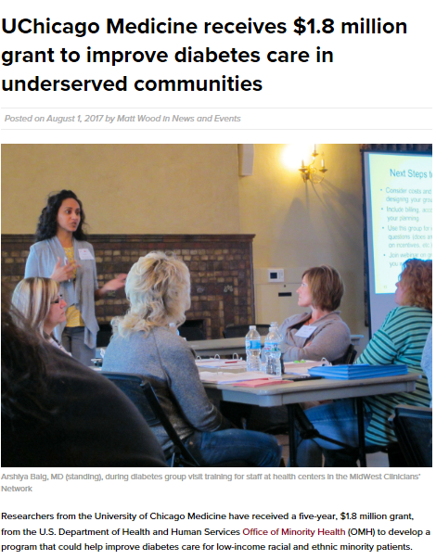

Office of Minority Health (OMH)
Partnerships to Achieve Health Equity
Focus on improving access to care & health outcomes among disadvantaged populations through development of innovative models for managing chronic conditions
UChicago: One of 6 grantees across country
Cluster randomized trial & evaluate diabetes GVs and text messaging in Midwest HCs

Slide 47
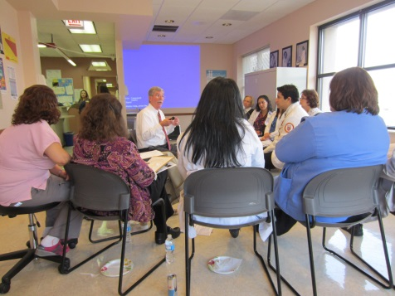

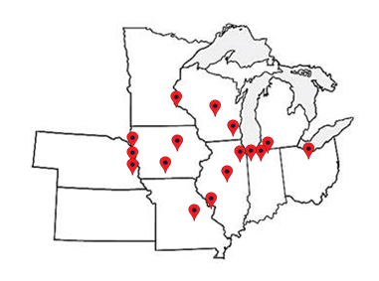
Diabetes MESSAGES
Design
  Cluster randomized study with waitlist control
  HCs had to form a team of 3-4 HC staff including one clinician (MD, NP, or PA)
  7 intervention and 7 waitlist control teams
Results
  Both group had improvement in A1c from baseline to 12 months
  Attending 4-6 group visits was associated with significant reduction in A1C compared to no visits 6 months and 18 months
  Patient improvement in social support and satisfaction with diabetes care
  Patient with emotional health problem more likely to see a mental health specialist and prescribed a medication in intervention group
  GV patients were more likely to have improved processes of care and more engagement with diabetes education post-intervention.
Notes:
Add logo

Slide 48

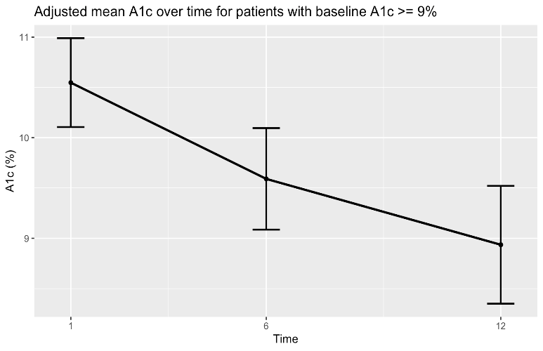
Virtual Group Visit Pilot
Study Design
  Conducted virtual GVs with pre and post data of 2020 cohort wait list arm
  6 sites
  49 patients enrolled
Results
  Trend for improvement in A1c in cohort from pre to post testing baseline to 12 months
  For patients with A1C≥9% at baseline (N=31), there was a significant decrease in A1C from 10.70±1.65% at baseline to 9.36 ± 2.07% at 6 months (p=0.03).
  Diabetes support and diabetes distress improved

Slide 49





Virtual Diabetes Group Visits Across Health Systems (VIDA)
  Main Objective:
  Assess changes in clinical outcomes among adults with T2DM and CVD comorbidities in virtual diabetes group visits versus usual care.

Slide 50
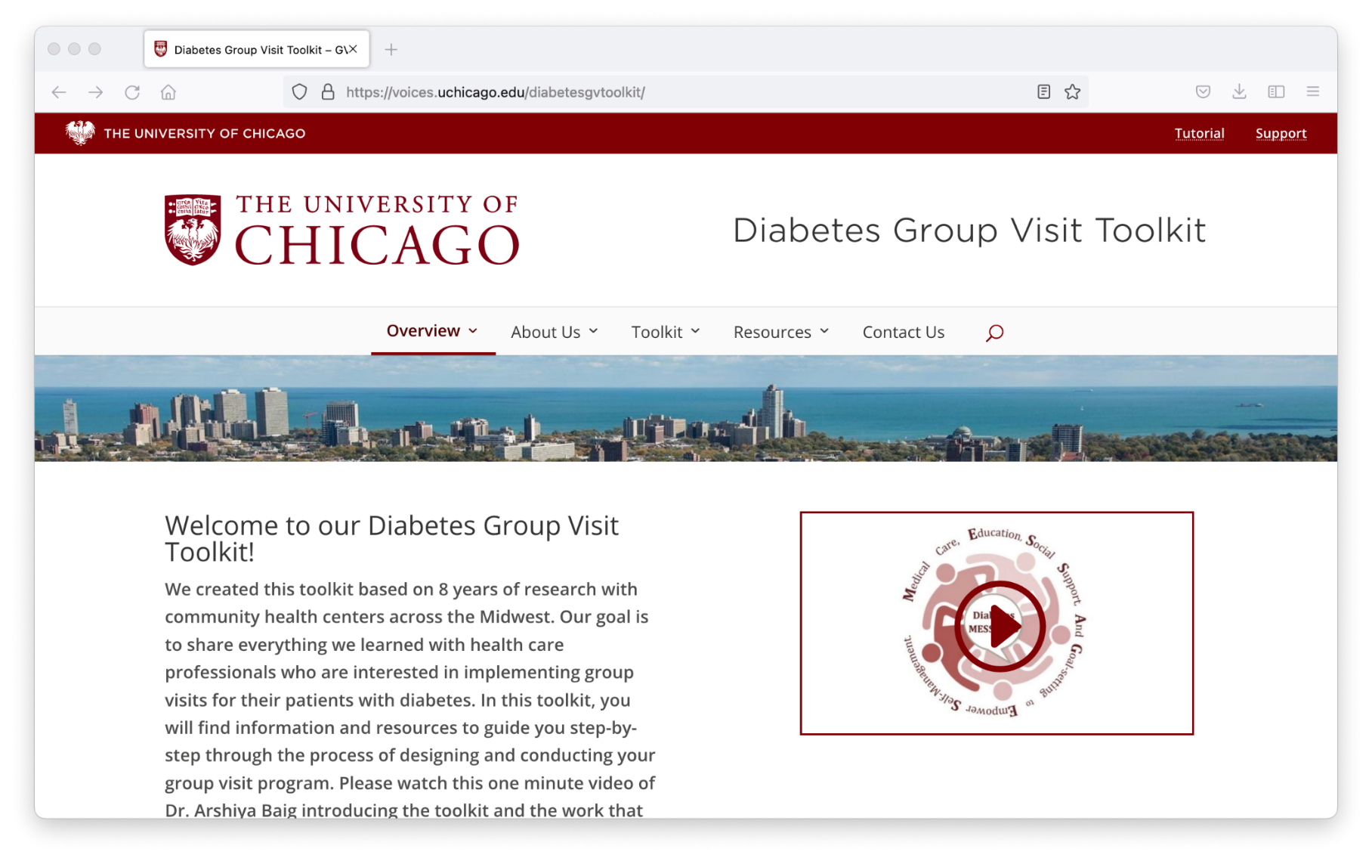
voices.uchicago.edu/diabetesgvtoolkit
Diabetes Group Visit Toolkit

Slide 51
Contact Info
Arshiya A. Baig, MD, MPH
Associate Professor of Medicine abaig@medicine.bsd.uchicago.edu
Amanda Campbell, Executive Director acampbell@midwestclinicians.org
Cindy Schaefer PhD, RN, Chair Research Committee
cs101@evansville.edu

Slide 52











Preventing “Tipping Points” in
High Comorbidity Patients:
A Lifeline from Health Coaches
PI: Jonathan N. Tobin, PhD (CDN/The Rockefeller University)
Co-PI: Mary Charlson, MD (Weill Cornell Medicine)
Co-I: Nivedita Mohanty, MD (AllianceChicago)
Funding:
PCORI Award #IHS-2017C3-8923
With support from:
AHRQ Grant #P30-HS-021667
NYC-CDRN (INSIGHT) PCRF Award #20171205
CAPriCORN PCRF Award #20171205

Slide 53
Presentation Overview
This presentation will discuss:
Community-Academic Partnerships and Networks of Networks
Design of a Cluster-Randomized Pragmatic Multi-level Intervention Trial
Intervention Targeted at Patients with High Comorbidity

Slide 54
Acknowledgements
Clinical Directors Network (CDN):
Jonathan N. Tobin, PhD
Andrea Cassells, MPH
Ilana Mittleman, MPH
TJ Lin, MPH
Weill-Cornell Medicine:
Mary E. Charlson, MD
Erica Phillips, MD
James P. Hollenberg, MD
Rosio Ramos, BA
Martin Wells, PhD
AllianceChicago:
  Fred Rachman, MD
  Nivedita Mohanty, MD
  Alice Eggleston, PA-C, MPH
Health Coaches:
Andy Cruz, Jackie Cruz, Azalia Garcia, Cynthia Mofunanya, Ariana Perdomo, Annette Rueda, Maria Ruiz, Stephanie Vasquez
Health Center Partners:
CHN: Crown Heights, Harlem, Long Island City, Sutphin
NYU: Flatbush, Park Ridge, Park Slope, Sunset Park
Erie: Division Foster, Waukegan, West Town
Friend: Ashland, Cottage Grove, Pulaski, Western
Research reported in this presentation was funded through a Patient-Centered Outcomes Research Institute (PCORI) Award (IHS-2017C3-8923).
The views, statements, opinions in this presentation are solely the responsibility of the authors and do not necessarily represent the views of the
Patient-Centered Outcomes Research Institute (PCORI), its Board of Governors or Methodology Committee.

Slide 55

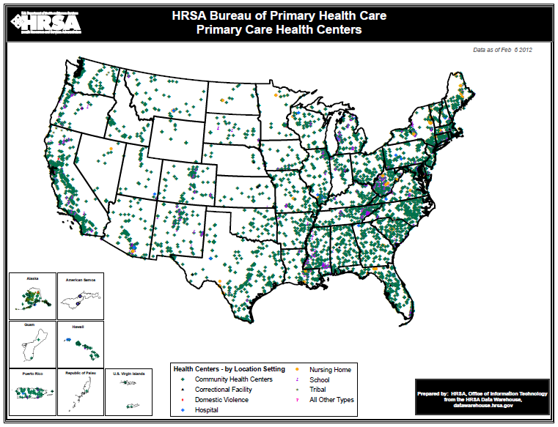
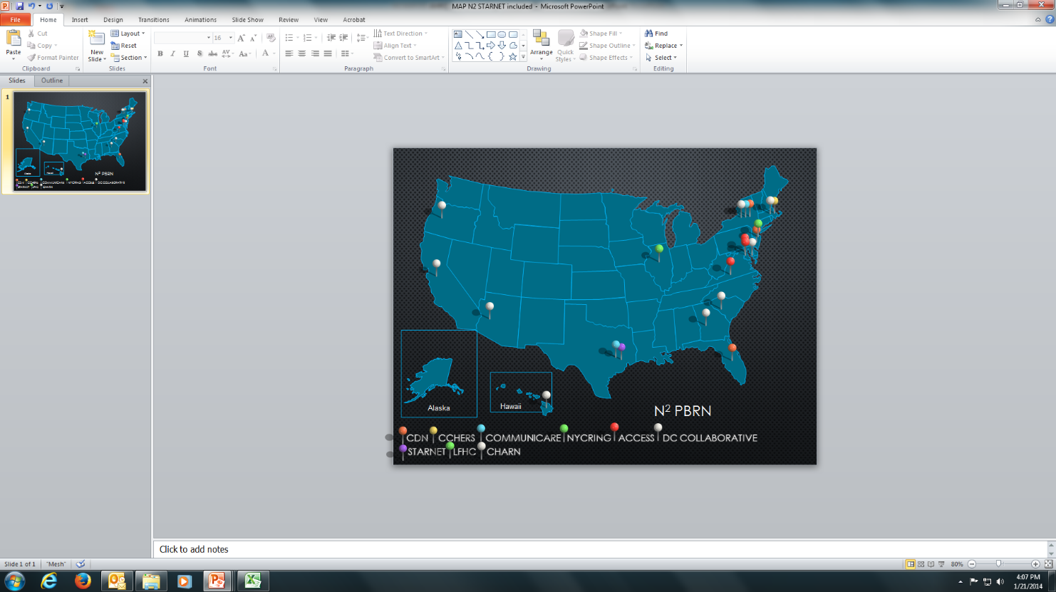
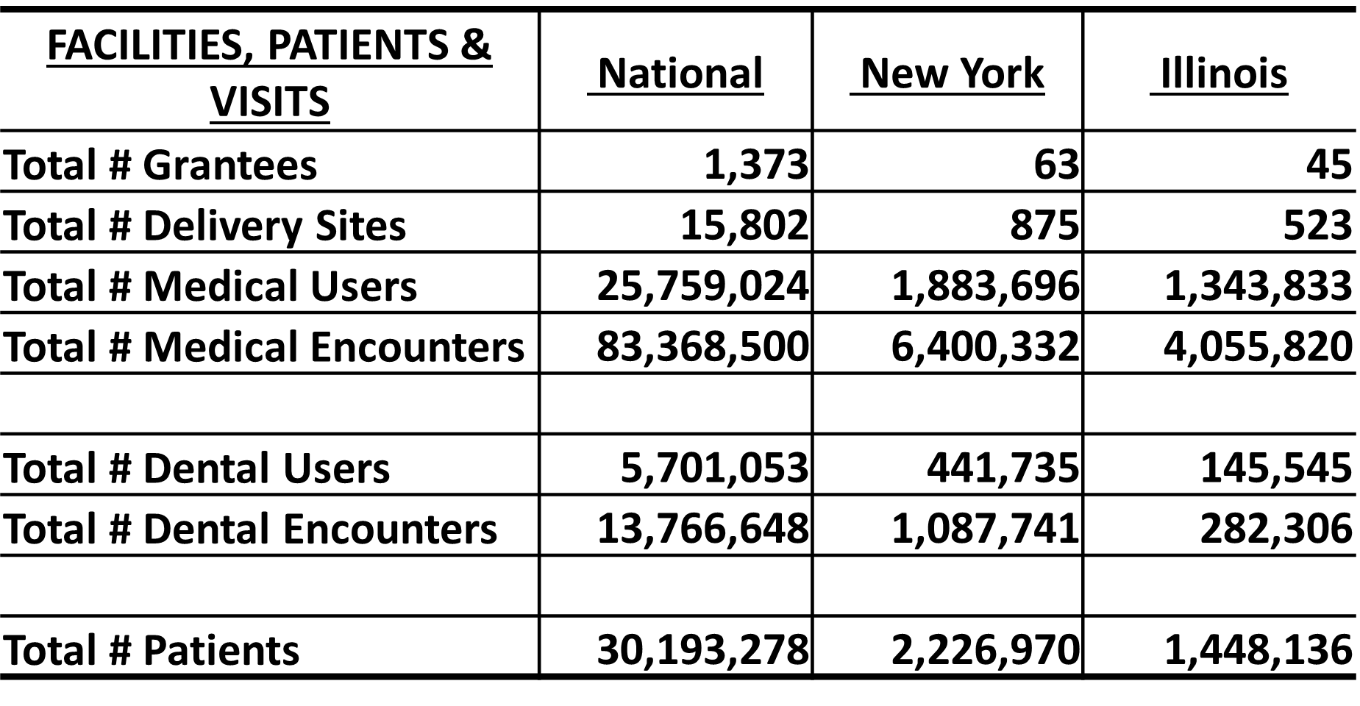

  CDN N² –PBRN: Building a Network of Safety Net PBRNs
CDN is a Practice-Based Research Network (PBRN) that works with Federally Qualified Health Centers (FQHCs) and other
primary health care safety-net practices
DHHS – HRSA: The Primary Health Care Safety-Net
CDN N2-PBRN
1373 Grantees, 9,000 sites,
27 million patients
9 PBRNs,
600 sites,
4.5 million patients
HRSA UDS 2021 Data
CDN is an
AHRQ-designated
Center of Excellence for
Practice-based
Research
and Learning
Funded by AHRQ Grant: P30-HS-021667
PI: Jonathan N. Tobin, PhD (CDN)
www.CDNetwork.org

Slide 56
n²-pbrn
Scale-up Model
N² -PBRN
CDRNs
PBRNs
FQHCs
CDN N²-PBRN has built a scalable research infrastructure
to serve the needs
of clinicians who practice
in the health care safety-net
By building on existing infrastructure,
creating new relationships providing external practice facilitators (online, remote)
and dissemination channels
Notes:
SCALE-UP MODEL:
Health Care Safety-Net
⬇
Community/Academic Research Partnerships
⬇
Clinician Engagement
⬇
eCME
⬇
EHR based research
⬇
Big Data/
Learning Health Care System

Slide 57
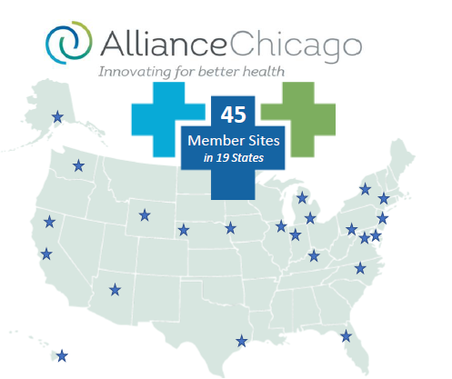
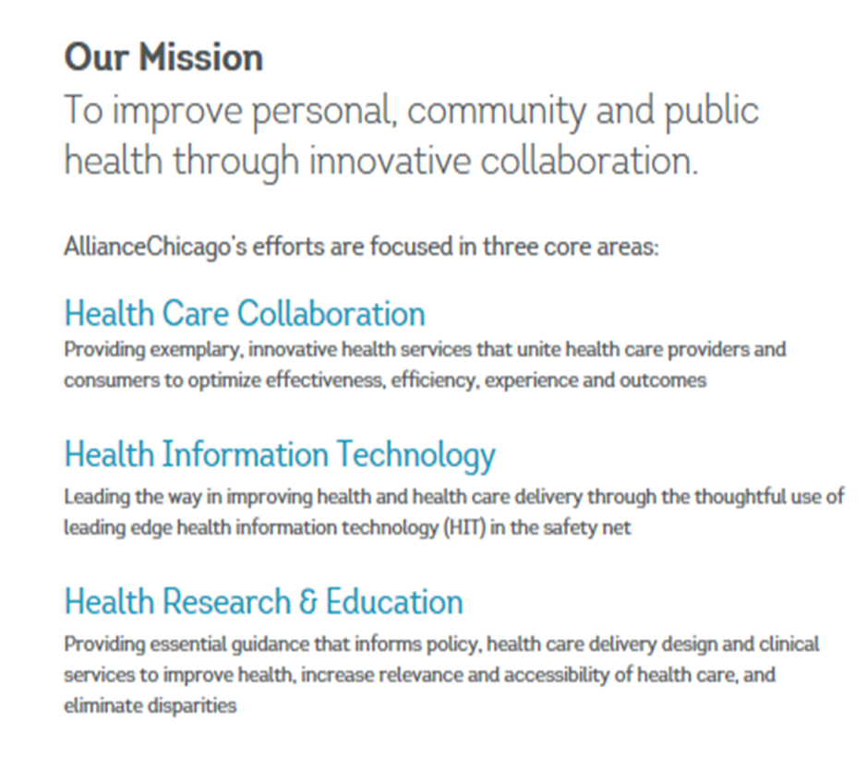
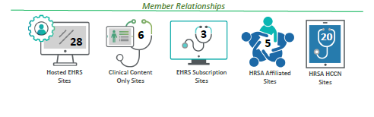
A centrally-hosted electronic health record solution for Community Health Centers
>2.6 Million: Unique, Active, Patients in Enterprise Data Warehouse (24% 18 and under)
Access to tools and services through subscription for other health centers who have alternative arrangements for hosting their EHR.
Quality Improvement, Strategic Planning, Research
www.alliancechicago.org

Slide 58
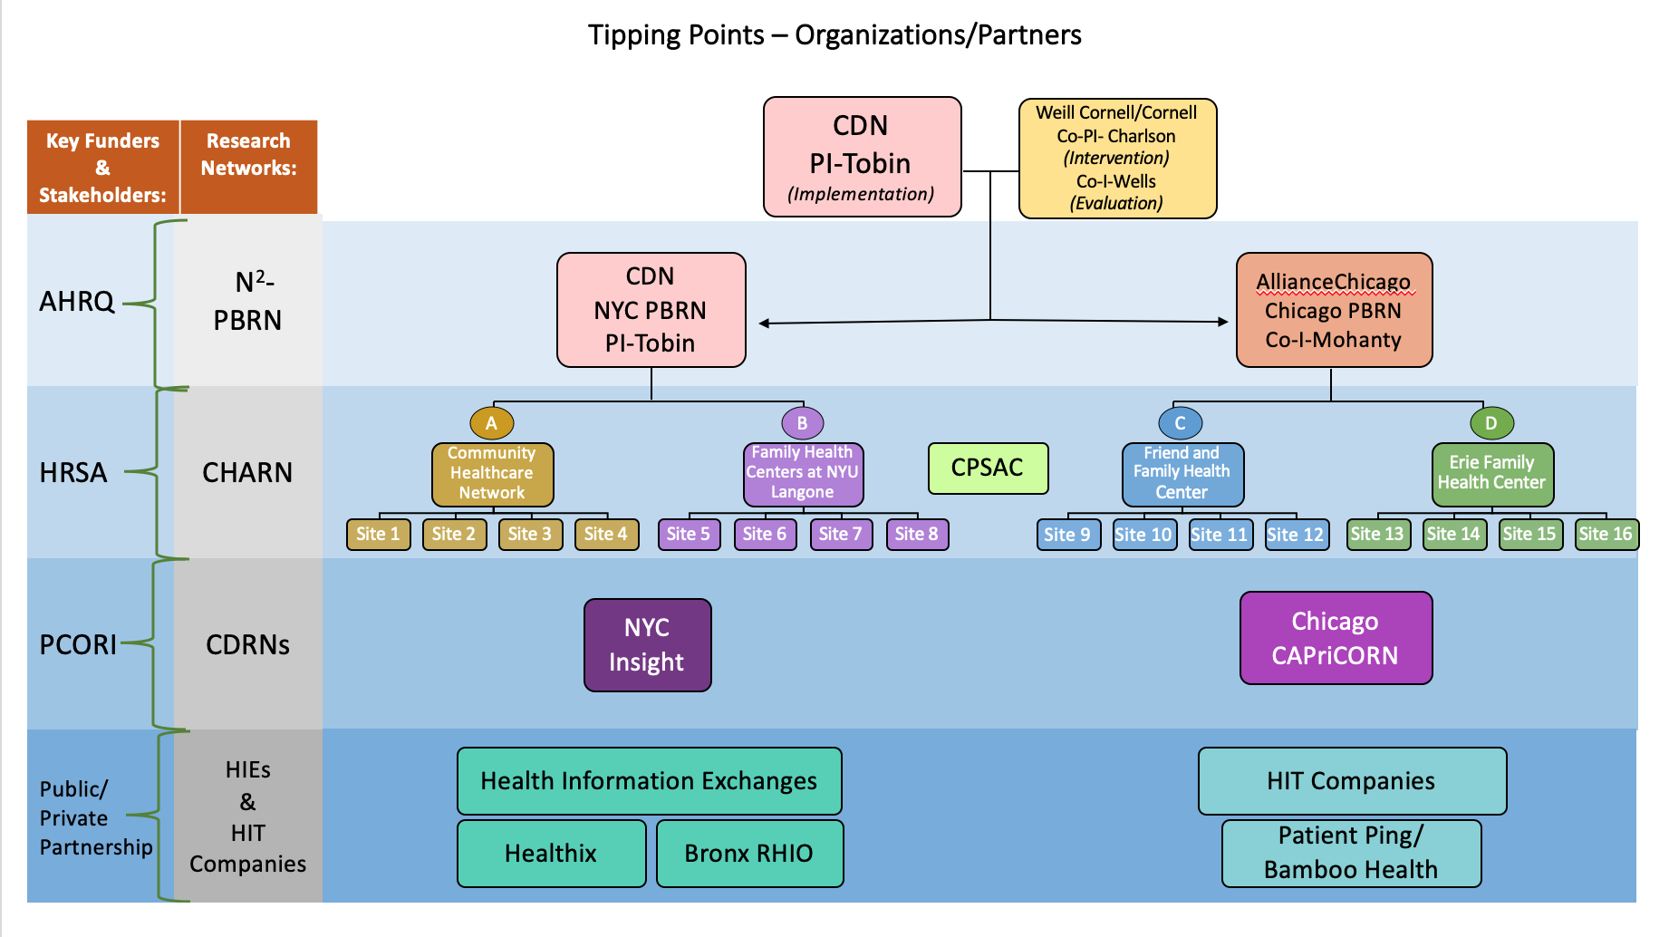
Notes:
Add in rows at the bottom for HIE

Slide 59
Data Sources and Partnerships
 | N²-PBRNs |  | FQHCs |  | CDRNs |  | HIEs & HIT Companies
 | CDN | Alliance Chicago | NYU and CHN | Erie and Friend | Insight | Capricorn | Healthix, Bronx RHIO | Azara & Relevant | Bamboo Health
EHR |  |  | EPIC & eCW | EPIC & Athena
Determination of Eligibility
Co-morbid diagnoses |  | X | X | X |  |  |  | X
Confirm CCI > 4 | X | X | X | X |  |  |  | X
Recruitment
Contact information - phone, email, mail, text | X | X | X | X
Intervention Delivery
Communication with primary care team via EMR | X | X | X | X |  |  | X |  | X
Goal setting | X | X
Participant Retention
Contact information - phone, email, mail, text | X | X | X | X
Outcome Ascertainment
Hospital admissions |  |  | X | X | X | X | X |  | X
ED visits |  |  | X | X | X | X | X |  | X

Slide 60
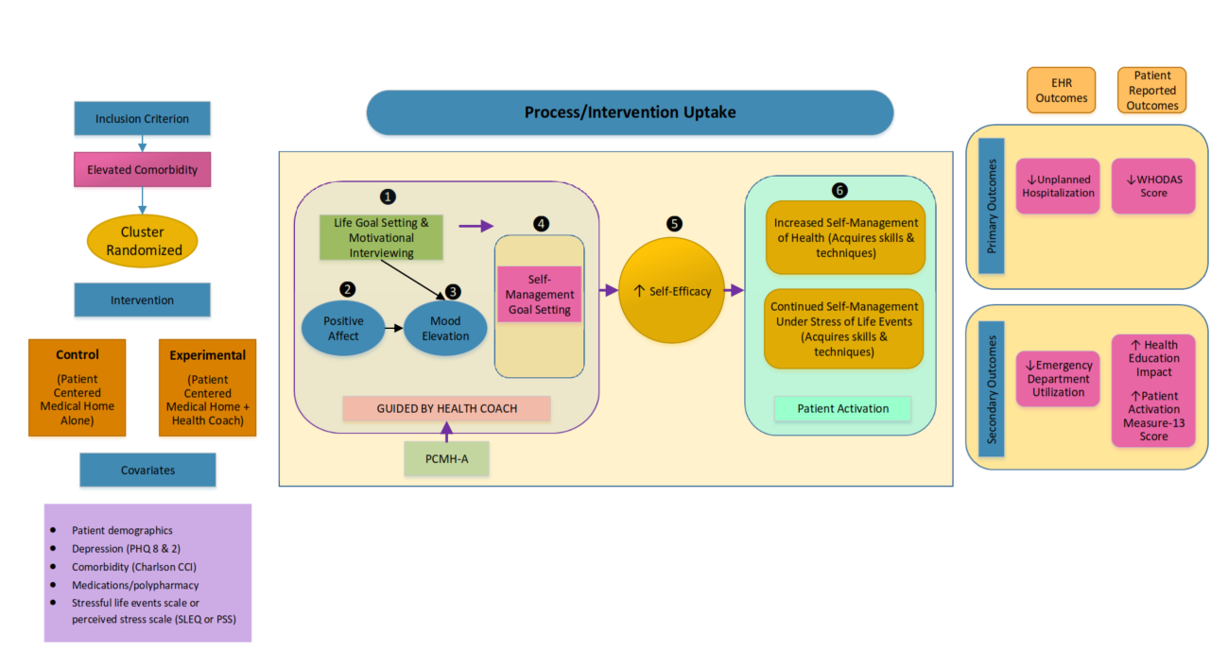
Tipping Points - Logic Model
Notes:
Drop if too many slides

Slide 61
Tipping Points – Practice Settings
Predominantly low-income, black and Latino/a adult patients with multiple chronic diseases defined by Charlson Comorbidity Index of >4
    Trained Health Coaches conduct recruitment, assessment and intervention at 4 Federally Qualified Health Center networks
NYC | Chicago
Family Health Centers at NYU Langone | Erie Family Health Center
Community Healthcare Network | Friend Family Health Center

Slide 62
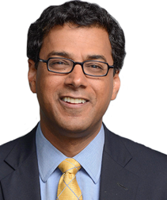
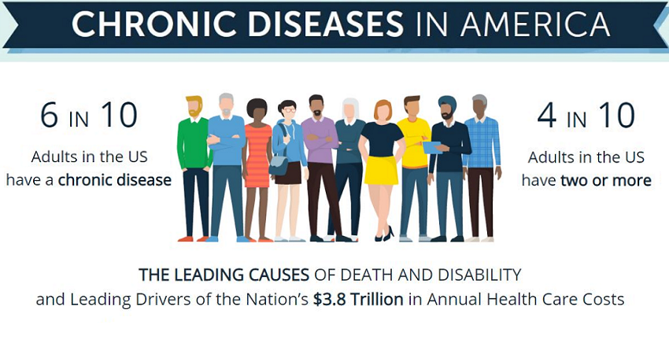

*Centers for Disease Control and Prevention
-Dr. Atul Gawande
Chronic Disease Management including Diabetes Care is optimized by a team-based approach
Health Coaches can expand the reach and capacity of the Primary Care team
Tipping Points engages Clinical Champions, Health Center Operations, and Patients
A Patient and Clinician Advisory Board promotes continuous communication between the Research Teams and practice-level factors

Slide 63

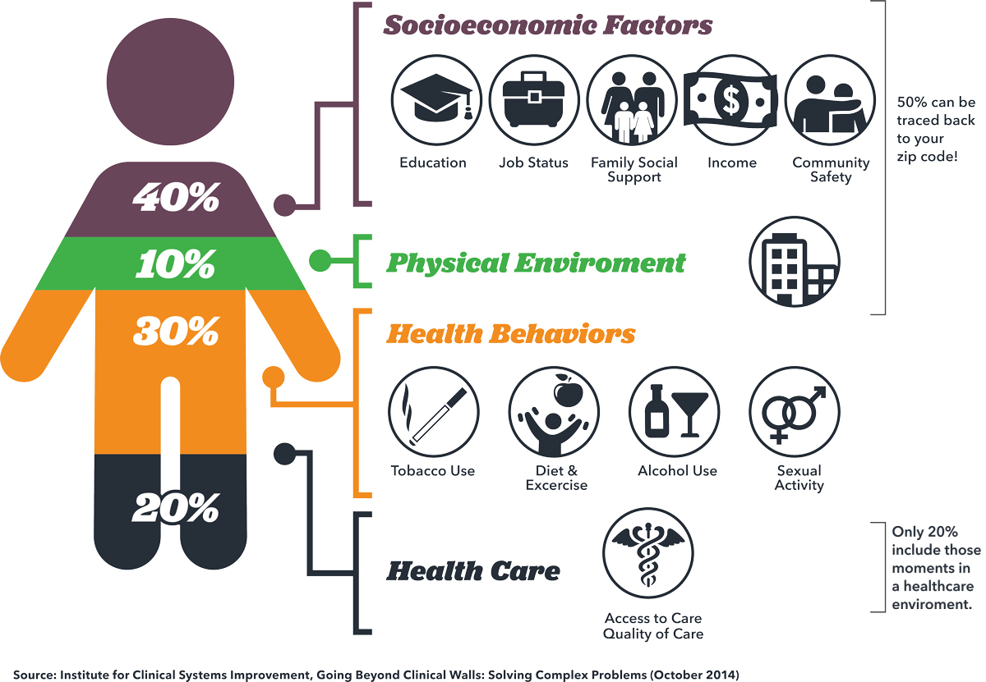
Implementation of Research in Real-World Settings
Health Coach Training
Health Coach Orientation and Integration with Clinical Champions and Care Teams
Tailored strategies for integration within each clinical environment
  Warm Hand Offs
  Integration with Team Huddles
  Remote Recruitment and Patient Touchpoints
  Supporting patient with community resources to address needs
  Closing communication loops with the Primary care teams

Slide 64
Tipping Points Intervention
Experimental Arm Includes:
Setting life goals and self-management goals with Health Coaches to engage patients
Coaching toward self-management goals shared with patient’s primary care clinician and Health Coach to work with patient to develop an action plan for when they should contact their clinician
Emotional and tangible support for life stresses Patients in the PCMH+ coaching intervention can contact the Health Coach if they need help because of new life events, psychosocial challenges, new diagnoses or deterioration in their current social or clinical status. The Health Coach encourages patients to mobilize family and friends to provide support.

Slide 65
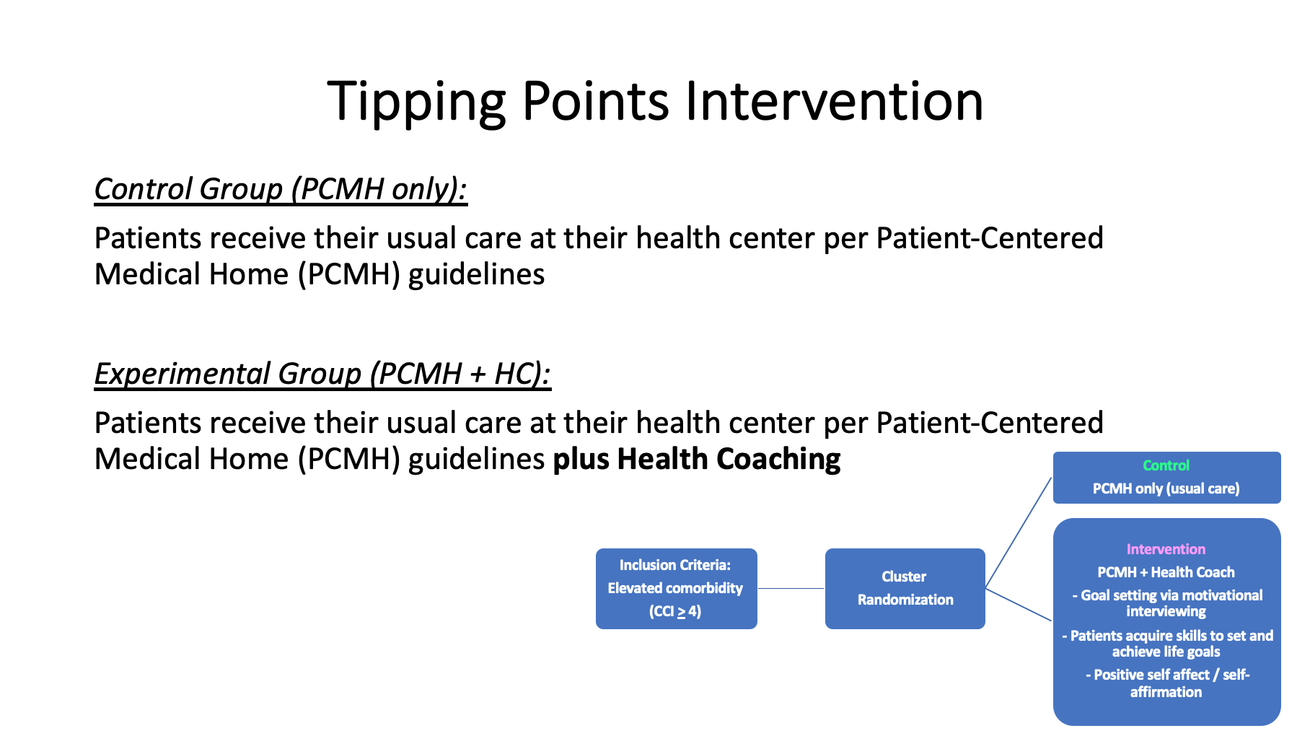

Slide 66
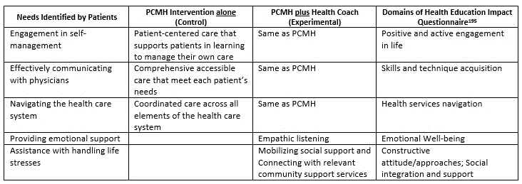
Tipping Points
PCMH vs. PCMH + Health Coaching

Slide 67
Baseline Demographics in Chicago & NYC
 |  | CHICAGO | NYC | TOTAL
 |  | N (%) | N (%) | N
 |  | 587 (50%) | 583 (50%) | 1170
Age | Mean age | 56.5 (±10.8) | 61.9 (±11.0) | 59.2 (±11.2)
Gender | Female | 409 (70%) | 443 (76%) | 852 (73%)
Race | Black | 270 (48%) | 273 (49%) | 543 (46%)
 | White | 121 (22%) | 48 (9%) | 169 (14%)
 | Asian/Indian/Alaskan/ Hawaiian/Pacific Islander | 29 (5%) | 12 (2%) | 41 (4%)
 | Other | 142 (25%) | 225 (40%) | 367 (31%)
Hispanic/Latino | Yes | 240 (58%) | 236 (58%) | 476 (41%)
CCI | 4 | 142 (24%) | 205 (35%) | 347 (30%)
 | 5 | 142 (24%) | 153 (26%) | 295 (25%)
 | 6 - 7 | 171 (29%) | 168 (29%) | 339 (29%)
 | 8+ | 132 (22%) | 57 (10%) | 189 (16%)

Slide 68
Comparison of Participants with and without Diabetes at Baseline
 |  | DIABETES | NO DIABETES | TOTAL
 |  | N (%) | N (%) | N
 |  | 801 (74.4%) | 276 (25.6%) | 1077
Age | Mean age | 59.3 (+10.3) | 57.7 (+12.8) | 59.1 (+11.1)
Gender | Female | 582 (73%) | 206 (75%) | 788 (73%)
Race | Black | 365 (46%) | 158 (57%) | 523 (49%)
 | White | 114 (14%) | 48 (17%) | 162 (15%)
 | Asian/Indian/Alaskan/ Hawaiian/Pacific Islander | 27 (3%) | 14(5%) | 41 (4%)
 | Other | 295 (37%) | 56 (20%) | 351 (33%)
Hispanic/Latino | Yes | 366 (46%) | 75 (27%) | 441 (41%)
CCI | 4 | 224 (28%) | 95 (34%) | 319 (30%)
 | 5 | 195 (24%) | 76 (28%) | 271 (25%)
 | 6 – 7 | 242 (30%) | 69 (25%) | 311 (29%)
 | 8+ | 140 (17%) | 36 (13%) | 176 (16%)
Hypertension | Yes | 692 (86%) | 193 (70%) | 885 (82%)

Slide 69
Conclusions
PBRNs can collaborate with CDRNs to conduct multi-site, multi-state pragmatic clinical trials which include patient-reported outcomes when using a “network of networks” model
Diabetes (often accompanied by hypertension) is a high prevalence condition among patients with multiple co-morbidities
Goal-setting and support that extend the reach of the primary care team are key features of Tipping Points
Destabilizing events, such as Emergency Department visits and Unplanned Hospitalizations, are outcomes that can be ascertained electronically, and that matter for a range of stakeholders, including :
  Patients
  Caregivers
  Clinicians & FQHC staff
  Health systems
  Total Cost of Care

Slide 70
?
?
Q&A Session
?

Slide 71
This webinar is sponsored by:
Chicago Center for Diabetes Translation Research (NIDDK, Grant No. 2P30DK09294911)
CDN Center of Excellence (P30) for Practice-based Research and Learning
N²: Virtual Training Series (AHRQ, Grant No. 1P30HS021667)
Preventing Tipping Points in High Comorbidity Patients: A Lifeline from Health Coaches, (PCORI Grant #IHS-2017C3-8923)
University of Chicago
Northwestern University
Clinical Directors Network, Inc. (CDN)

