Slide 1
Building Diagnostic Excellence:
Tools for the Journey
Chris Goeschel ScD RN FAAN
Katie Carlin MBA
MedStar Institute for Quality and Safety
September 20, 2022

Slide 2
The work we will discuss:
Prepared for:
Agency for Healthcare Research and Quality 5600 Fishers Lane Rockville, MD 20857 www.ahrq.gov
Prepared by:
MedStar Health Institute for Quality and Safety, AHRQ. Columbia MD. Christine Goeschel ScD, RN
Center for Innovations in Quality, Effectiveness, and Safety (IQuESt), Michael E. DeBakey Veterans Affairs Medical Center and Baylor College of Medicine, Houston, TX Hardeep Singh, M.D., M.P.H.
Contract Number HHSP233201500022I/75P00119F3700

Slide 3
Session Objectives
Define diagnostic error and its’ importance as a patient safety issue
Describe the impact of provider communication breakdowns on diagnostic safety
Specify why TeamSTEPPS is an appropriate intervention to reduce diagnostic error
Demonstrate an understanding of how leaders can take actionable steps using existing resources to facilitate diagnostic safety

Slide 4
Diagnostic Error Is Common and Harmful and Affects Many
What do we know? | How do we know it? | Who should get the message?
 |  | Leadership/ C-Suite | Dx Team: Clinicians+ | Dx Team: Patients+ | General Public
We know it’s real | NAM, WHO | X | X | X
 | SIDM, AHRQ, Diagnosis-based Patient Organizations |  | X | X | X
 | Peer Reviewed Publications | X | X
 | Event, Med Mal, National Data Sets | X | X
We know it hurts | Patient Stories, Blogs, Registries |  | X | X | X
 | Patient Satisfaction Surveys, Complaints | X |  | X
 | Employee Satisfaction, Culture Surveys | X | X
We know it has consequences | Lawsuits, Financial Impact, Business Losses | X | X
 | Media Coverage, Optics, Reputation | X | X |  | X
 | Increased Errors, Burnout, Workforce Reduction | X | X
We know (some) ways in which we can make it better | Awareness, Education | X | X | X | X
 | Teamwork, Communication |  | X | X
 | System (Process) Improvements | X | X | X
 | Decision Support Tools |  | X | X
 | Research, Policy |  | X | X
Notes:
Diagnostic error is common and harmful and affects many. Appropriate communication can mitigate diagnostic errors. A lot of information about the diagnostic process is known by what we learn from patient stories, frontline accounts, liability claims, and research. We know that diagnostic error is real, it causes harm for our patients and their families, and if unaddressed, it can have serious consequences for many others. We all can improve this process.
It is important to tailor communication about the diagnostic process and diagnostic errors to various stakeholders across the delivery system. This table, located in the Participant Workbook, is a list of stakeholders who may benefit from learning about diagnostic error and their role in improving the diagnostic process. This list is not exhaustive, but rather an example of how to tailor messages for the greatest potential impact. It is important to know your audience when soliciting champions to support improvement efforts.
C Suite/Leadership: Given that many diagnostic errors take place in ambulatory care, it is important to recognize that C Suite leadership is likely related to hospital-based clinics and ambulatory centers under hospital leadership. However, we also need to think of office management if we are to get support for the entire diagnostic team.
Diagnostic Teams: Diagnostic teams vary in composition. Most people think of the doctors, but we know that it is also important to recognize others who are very much a part of the diagnostic process. “Clinicians+” as identified on the table is meant to depict all clinicians (primary care and specialists) PLUS the additional/extended/support staff who are part of the patient’s diagnostic journey (e.g., office staff who take calls, nurses and medical assistants who see patients during their visit, radiology and laboratory technicians who process tests and send results, physical and occupational therapists, home care staff who see patients at home). “Patients+” is meant to depict the patients and their families/support person(s). Clinicians+ and patients+ embody the comprehensive diagnostic team, although they have different needs, experiences, roles, and perspectives on the diagnostic process and how to improve it.

Slide 5




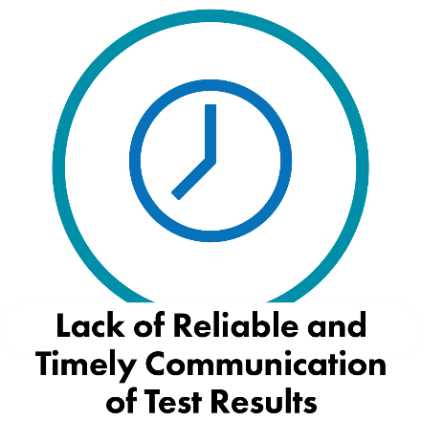
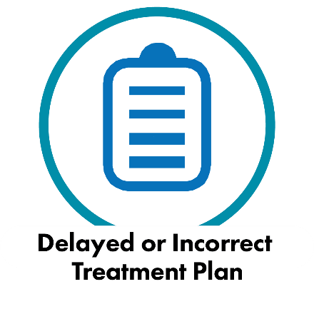

Causes of Diagnostic Error
Notes:
Diagnosis is one of the most complex processes in medical care. It is not surprising, therefore, that errors in the process occur. Peer review evidence, liability claims data, morbidity and mortality rounds, sentinel event data, and patient safety event data, as well as routine quality improvement projects, all provide insight on some of the causes of diagnostic error. These include but are not limited to:
Incomplete data.
Knowledge deficits.
Clinical reasoning deficits.
Lack of available expertise.
Lack of reliable and timely communication of test results.
Delayed or incorrect treatment plan.
Lack of communication and collaboration between clinicians, patients, and family members.

Slide 6
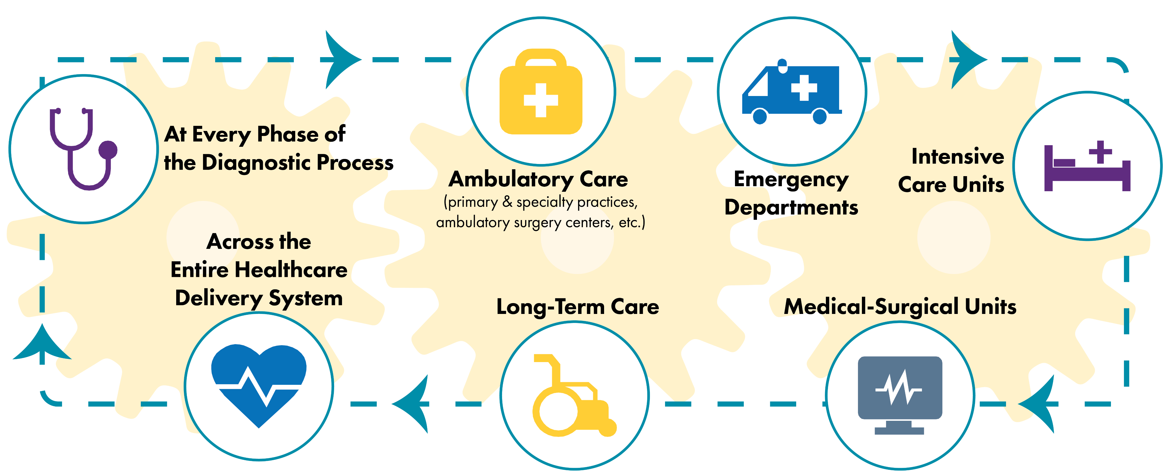
Where Do Diagnostic Errors Occur?
Notes:
Better identification, analysis, and implementation of approaches to improve diagnosis and reduce diagnostic error are needed throughout ALL healthcare settings. The term “healthcare” is used for simplicity but is meant to encompass all settings in which the diagnostic process takes place. Settings include integrated care delivery settings, hospitals (every unit), ambulatory care (primary and specialty practices, ambulatory surgery centers, etc.), retail clinics, and long‐term care settings. To put it simply, errors that affect diagnosis can occur anywhere in the healthcare delivery system.
(CRICO, 2014)

Slide 7
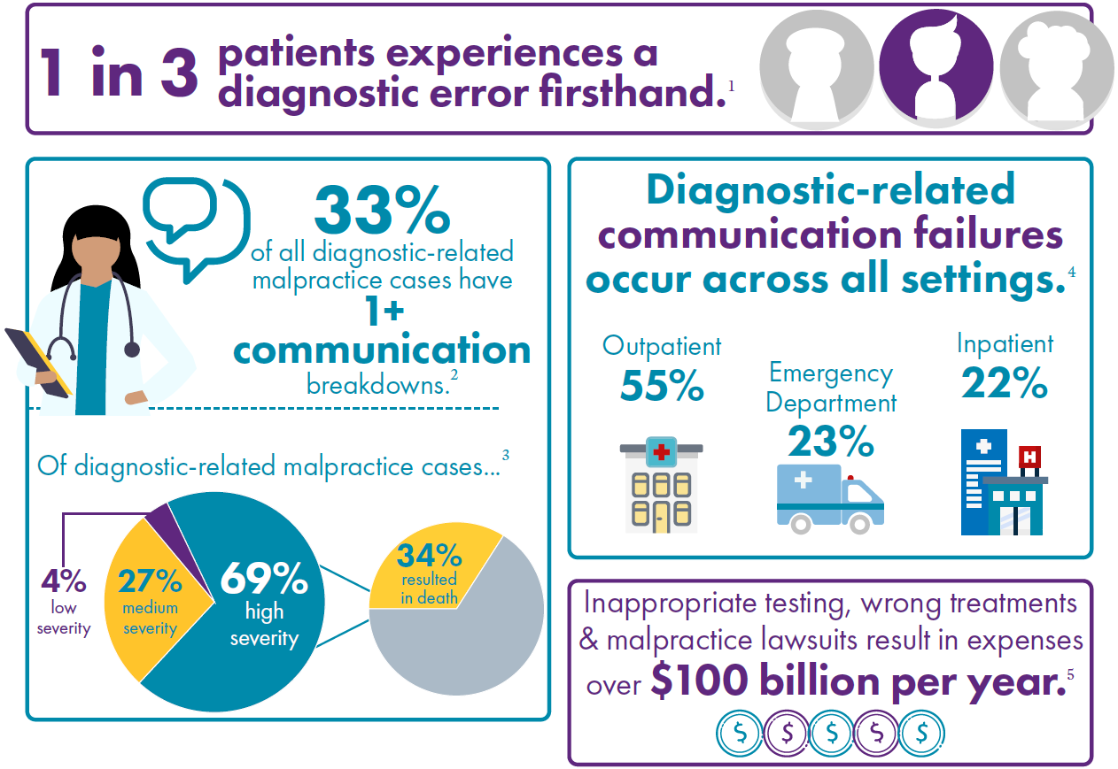
Why TeamSTEPPS® for Diagnosis Improvement

Slide 8
TeamSTEPPS® for Diagnosis Improvement

Slide 9




Course Development
APR-JUN
JUL-SEP
OCT-NOV
JAN-MAR
APR-JUN
JUN-SEP
OCT-DEC
JAN-MAR
Course Co-Production
with 8 subject matter experts
Revise
Final Product
2020
2021
2022
Course Co-Evaluation
with 16 pilot sites across the United States

Slide 10



Who is the Audience for the Course?
FAMILIAR WITH
TEAMSTEPPS
FAMILIAR WITH
DIAGNOSTIC SAFETY
EVERYONE
PERFORMANCE
Leadership
Communication
Situation
Monitoring
Mutual
Support
KNOWLEDGE
PATIENT CARE TEAM
ATTITUDES
This course is made for teams and individuals with TeamSTEPPS experience seeking to learn more about diagnostic safety.
This course is made for teams and individuals with diagnostic safety knowledge seeking to learn more about TeamSTEPPS.
This course is made for anyone looking to improve communication and teamwork in the diagnostic process.

Slide 11
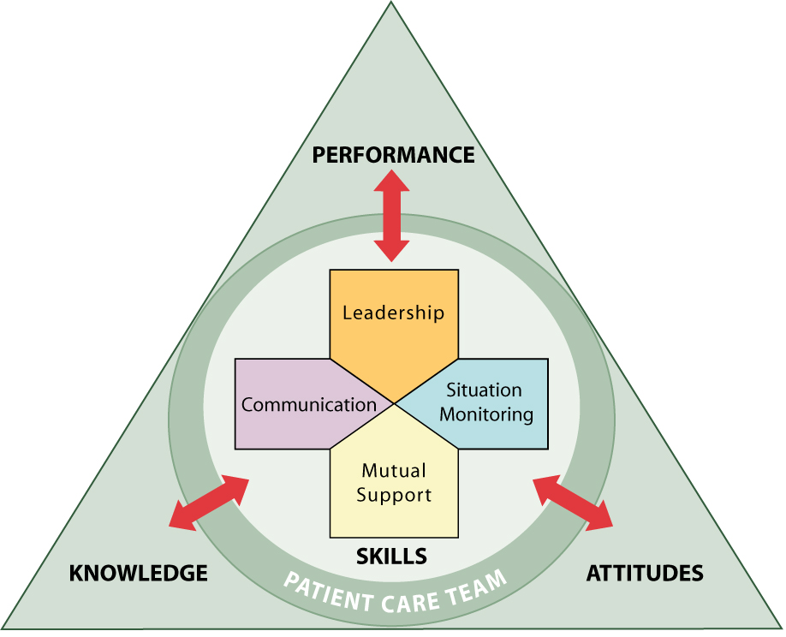
What Will Teams Learn?
Assessment
Clearly define the need.
Planning, Training, and Implementing
Plan to sustain the effort.
Train individuals.
Implement and test the strategies.
Sustainment
Integrate into daily practice.
Monitor and measure programs.
Notes:
The TeamSTEPPS framework is composed of four teachable, learnable skills – leadership, situation monitoring, mutual support, and communication. The red arrows on the graphic of the TeamSTEPPS framework depict a two-way dynamic interplay between the four skill areas and team-related outcomes.
When implementing TeamSTEPPS for Diagnosis Improvement, teams will learn about the four competency areas that lead to improved team performance, safer practices, and high-reliability culture:
Leadership: how to direct and coordinate, assign tasks, motivate team members, and facilitate optimal performance.
Situation monitoring: how to develop common understanding of a team environment, apply strategies to monitor teammate performance, and maintain a shared mental model. This skill includes having a sense of what is known and not known; what has been done or not done; and where things are in the diagnostic process.
Mutual support: how to anticipate other team members’ needs through accurate knowledge and shift workload to achieve balance during periods of high workload or stress.
Communication: how to effectively exchange information among diverse team members (including hands-on providers, clinical support staff, healthcare technicians, consultants, and others), regardless of how it is communicated.
Teams will also learn about specific tools and strategies that can be implemented locally to support these competencies. Some of these tools and strategies include:
SBAR.
Two-Challenge Rule.
Teach-Back.
Briefs.
Huddles.
The end result will be a higher performing team, where members:
Share a clear vision of the plan.
Use concise, structured communication techniques.
Have an accurate sense of where things stand.
Adapt readily to changing situations.
Maximize the use of information, skills, and resources for optimal outcomes.
TeamSTEPPS for Diagnosis Improvement addresses the dynamics that can occur among, physicians, nurses, other healthcare professionals, technicians, and administrative staff and with patients and families, all of whom are part of the diagnostic process.

Slide 12
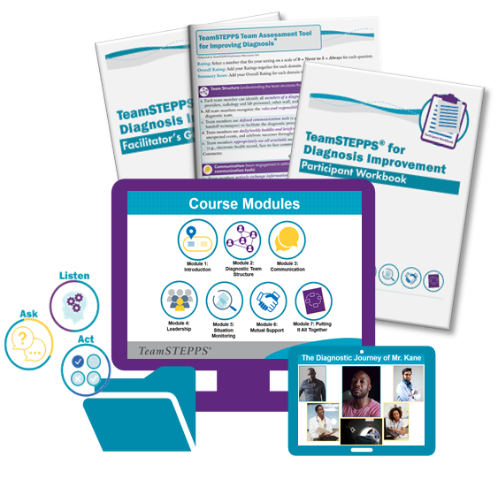
How is This Different than TeamSTEPPS® 2.0?
Diagnosis-Specific Focus:
Aims to raise diagnostic safety awareness, introduce the concept of a broad multidisciplinary diagnostic team that includes non-clinicians and patients and their families.
New Course Materials and Tools:
Team Assessment Tool for Improving Diagnosis
Reality-based case: The Diagnostic Journey of Mr. Kane
Reflective Practice Tool
Diagnosis Team Structure Tool
Diagnosis-Focused Referral Tool
Post-course Knowledge Assessment
Notes:
Number one question we get is “How is this course different than TeamSTEPPS 2.0?”
Taking TS body of evidence to the next level to move field of Dx Safety

Slide 13
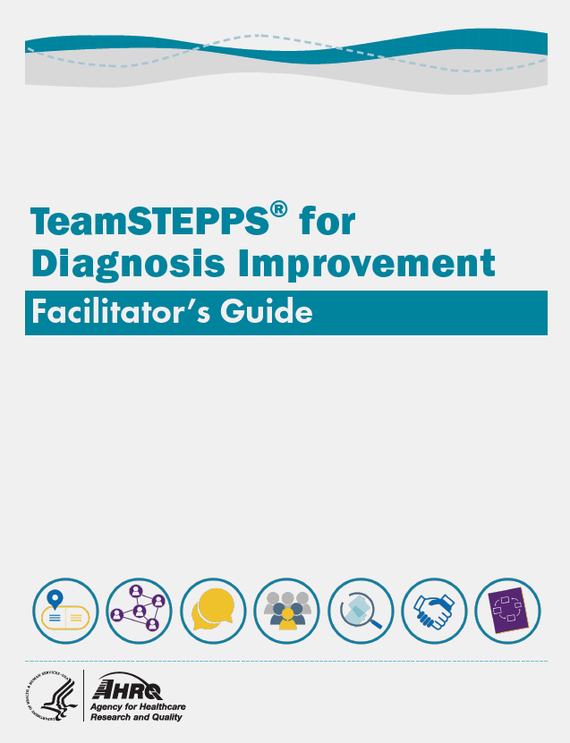
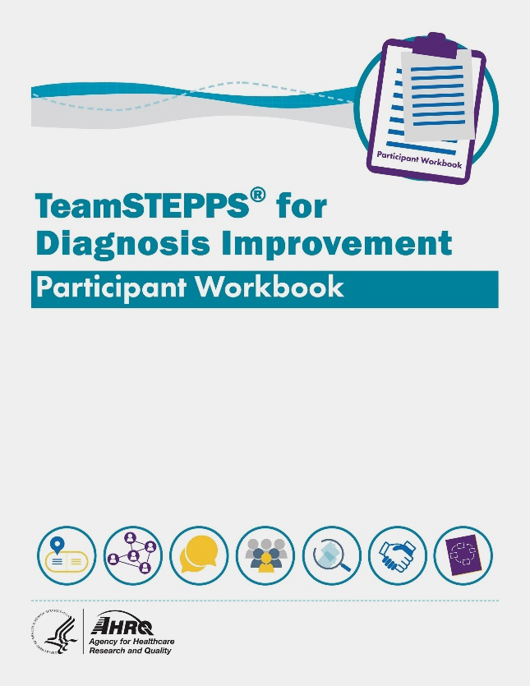
Introduction
Training on teamwork and communication to improve your diagnostic process.
TeamSTEPPS for Diagnosis Improvement aims to raise diagnostic safety awareness, introduce the concept of a broad multidisciplinary diagnostic team that includes nonclinicians and patients and their families, and provide assessment and training tools to support local efforts to reduce diagnostic harm.
Course materials:
7 Power Point Modules with Speaker Notes
Participant Workbook
Facilitator’s Guide

Slide 14
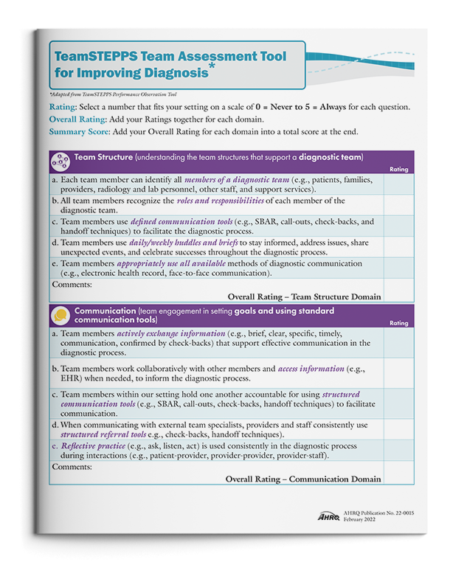
Team Assessment Tool for Improving Diagnosis
The Team Assessment Tool provides instructions to:
  Complete self-assessment ratings.
  Identify strengths and weaknesses.
  Set priorities and develop action plans.
  Assess improvement over time.

Slide 15





Course Case Study:
Mr. Kane’s Diagnostic Journey
Based on a real delayed-diagnosis experience.
Told through the many voices of Joe Kane’s diagnostic team.
Introduced in Module 1, incorporated throughout Module 2-6, and reimagined in Module 7.
This case shows how gaps in communication and care coordination can occur, despite providers’ dedication to care for their patients.

Slide 16


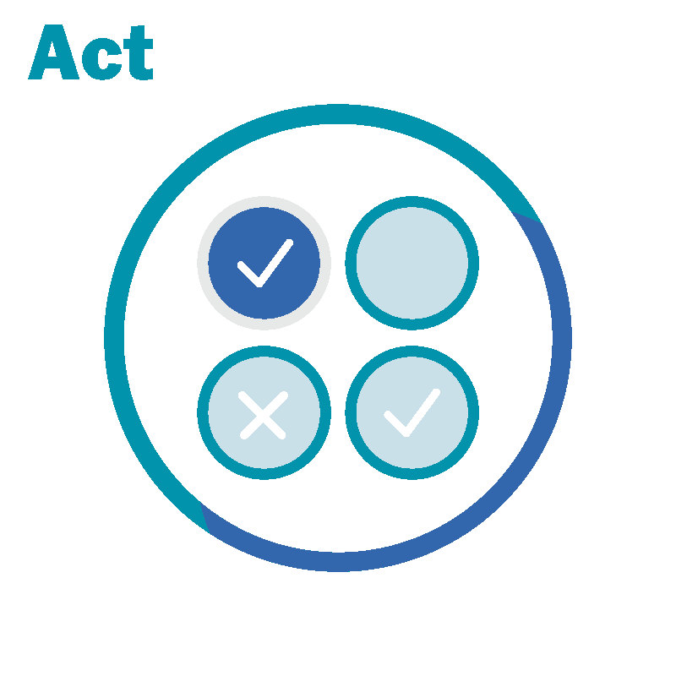
Reflective Practice
Questions are the path to discovery
Listen actively through mindful engagement
Follow-up with thoughtful action and planning

Slide 17
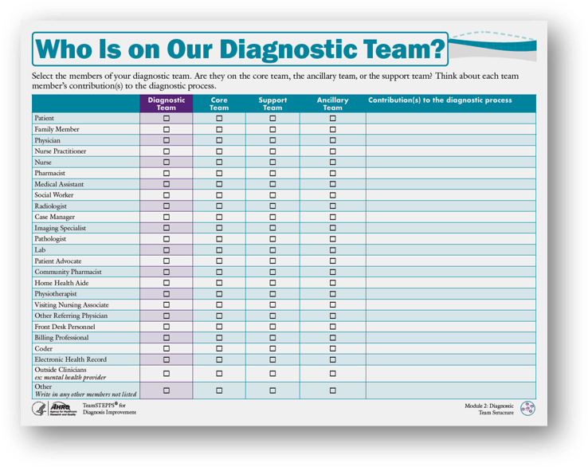
Diagnosis Team Structure Team Exercise

Slide 18
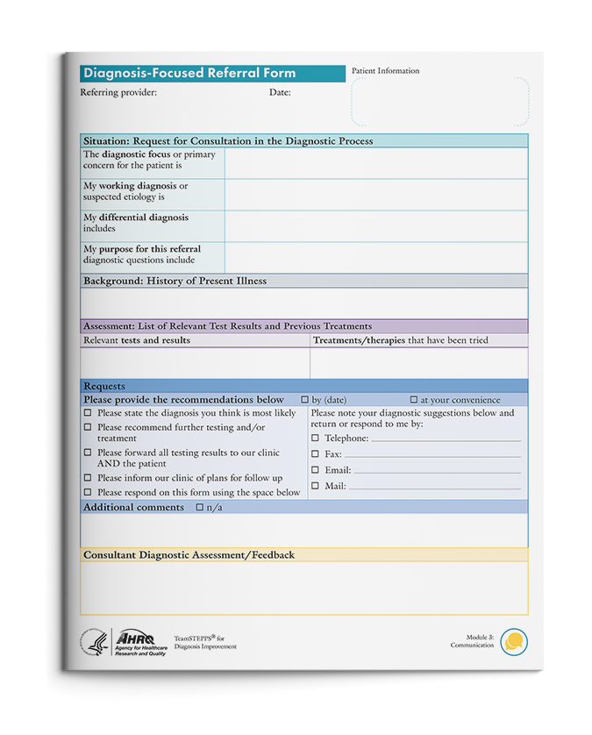
A Diagnosis-Focused Referral
This tool:
Uses the concepts from SBAR (Situation, Background, Assessment, and Recommendation).
Facilitates provider and patient alignment on the reasons for a diagnosis-focused referral and expected outcomes.
Helps structure communication from the referring provider to the consulting provider.

Slide 19
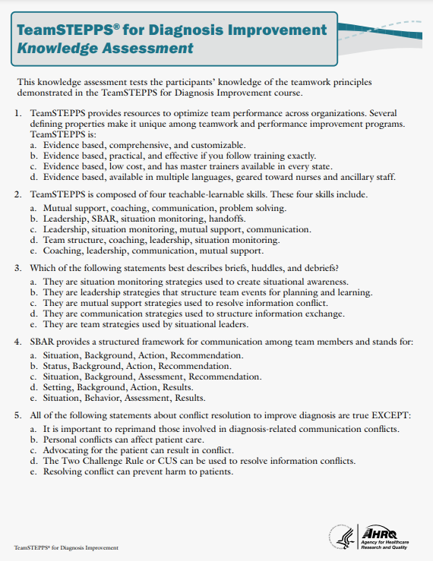
Knowledge Assessment
Evaluate your team's knowledge post-course through this 20-question assessment provided in the Facilitator’s Guide and Participant Workbook.

Slide 20







Course Modules Overview
Module 1: Introduction
Overview of diagnostic error, the TeamSTEPPS model, and the course materials.
Module 2: Team Structure
Explore the diagnostic team structure and roles
Module 3: Communication
Structured communication tools and strategies
Module 4:
Leadership
Defines effective team leadership. Provides guidance and tools.
Module 5: Situation Monitoring
Describes the effect on diagnostic safety and provides tools to improve outcomes.
Module 6: Mutual Support
Defines mutual support and its role in diagnostic safety.
Module 7: Pulling It All Together
Review of key concepts and reimagining the case study.

Slide 21
One Resource Among Many to Build Diagnostic Capacity

Slide 22
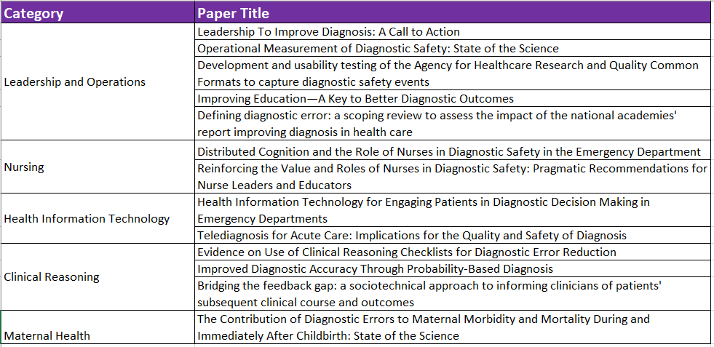
Dx Safety Capacity Building Papers
All publicly available at: https://www.ahrq.gov/patient-safety/reports/dxsafety-issuebriefs.html

Slide 23
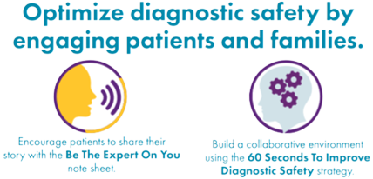
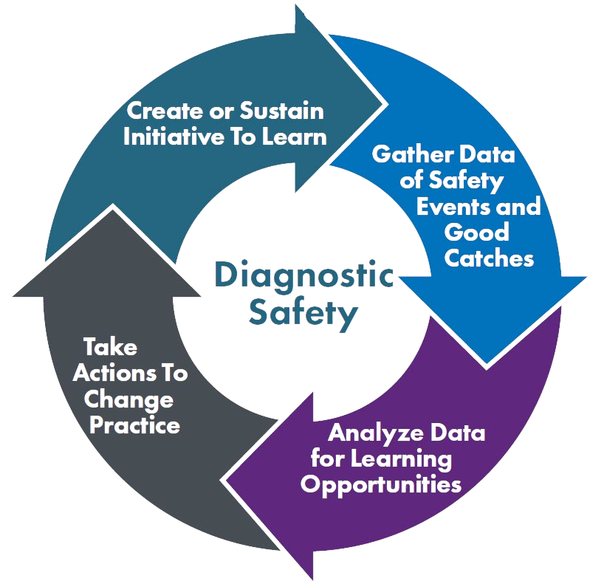




Dx Safety Capacity Building Resources
Toolkit for Engaging Patients To Improve Diagnostic Safety
TeamSTEPPS® for Diagnosis Improvement
Module 1: Introduction
Module 2: Diagnostic Team Structure
Module 3:
Communication
Module 4: Leadership
Encourage patients to share their story with the Be The Expert On You note sheet
Build a collaborative environment using the 60 Seconds To Improve Diagnostic Safety strategy
Module 5: Situation Monitoring
Module 6: Mutual Support
Module 7: Putting It All Together
Calibrate Dx: A Resource to Improve Diagnostic Decisions
Measure Dx
A tool for clinicians to evaluate and improve their own diagnostic decision-making.
Measure Dx helps healthcare organizations detect diagnostic safety events and learn from them to gain actionable insights for improvement.
Specify the calibration task
Plan and Apply improvement strategies
Evaluate diagnostic performance
Reflect on the exercise and adjust as needed
Recruiting Systems to Evaluate!
Coming October 2022!

Slide 24
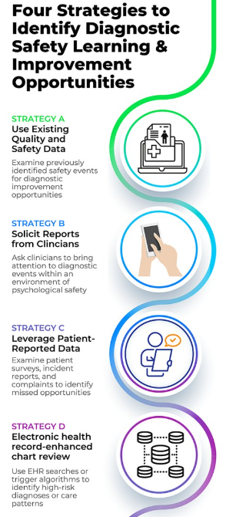
Measure Dx Evaluation
AHRQ is inviting healthcare organizations to implement Measure Dx as part of a further evaluation.
Participants will engage in monthly calls to share experiences with and learn from other organizations involved in the evaluation.
Organizations will be asked to provide aggregated anonymized data (no PHI or other identifiers).
For more information, please contact MIQSinfo@medstar.net

Slide 25
Questions?

Slide 26
Thank You
TeamSTEPPS® for Diagnosis Improvement
https://www.ahrq.gov/teamstepps/diagnosis-improvement/
Contact Us
MIQSinfo@medstar.net

